Slide 1


Systematic benchmarking of omics computational tools
Serghei Mangul, Ph.D
Department of Clinical Pharmacy
USC School of Pharmacy

Slide 2

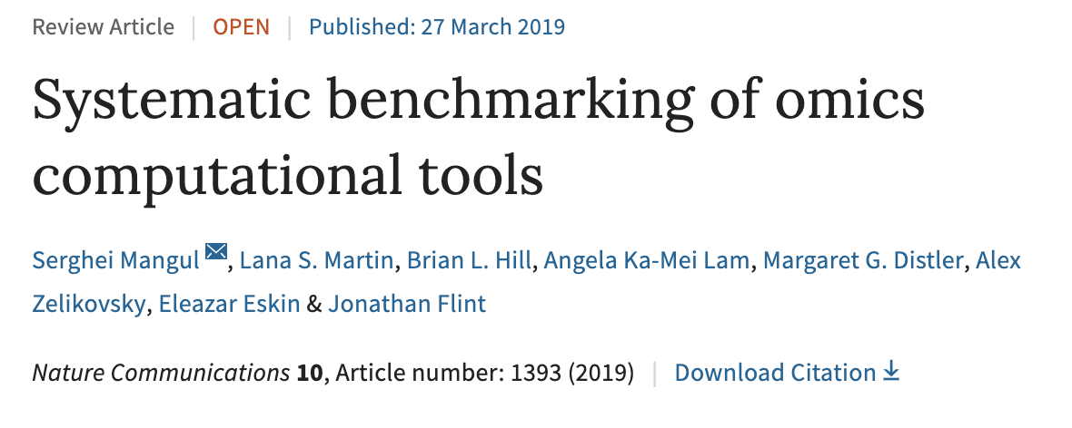

Slide 3
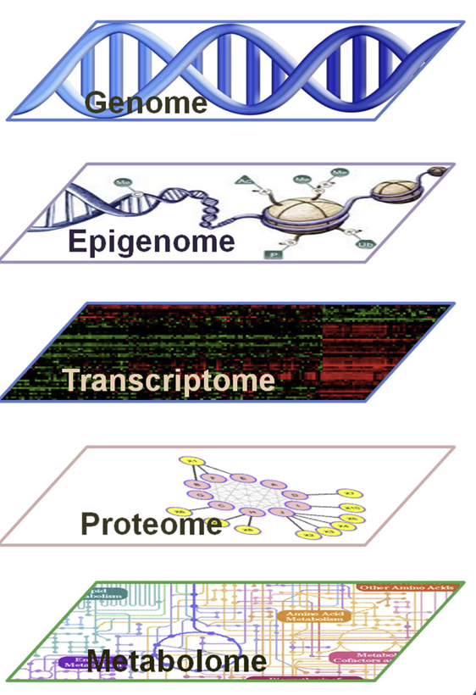
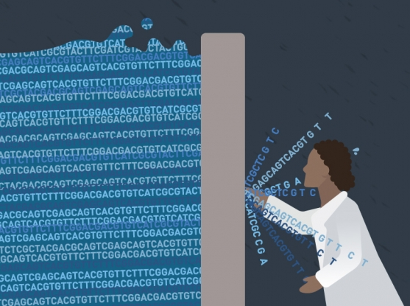
Flood of genomic data
Bioinformatics tool
S. Mangul "Interpreting and integrating big data in the life sciences." Emerging Topics in Life Sciences (2019)
Notes:
Recent advances in omics and sequencing technologies have led to the broad applicability of modern high-throughput technologies across various domains of computational biology.
Next-generation sequencing provides an unprecedented opportunity
to collect genomic data from hundreds of thousands of individuals providing the limitless potential for developing new treatments and personalized drugs.
Bioinformatic is improvering. All you need is just idea nd data is there
Despite the many advantages of modern sequencing technologies, interpretation of data produced
sophisticated computational algorithms that are capable to robustly interpret the data

Slide 4


How to choose the best tool?
Assessment of a newly-published algorithm is typically performed by the researchers who develop the tool
Can each published tools be the best performing tool?
self-assessment trap
Norel, Raquel, et all. Molecular systems biology 7.1 (2011): 537.

Slide 5
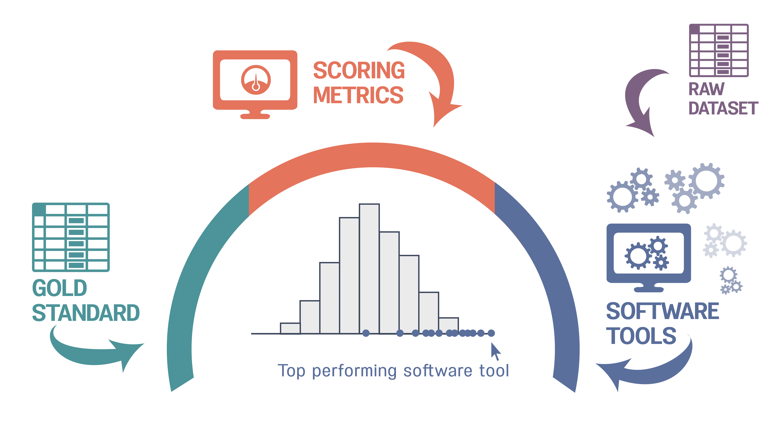
Solution: systematic benchmarking
Benchmarking – a robust and comprehensive evaluation of the capabilities of existing algorithms to solve a particular computational biology problem

Slide 6
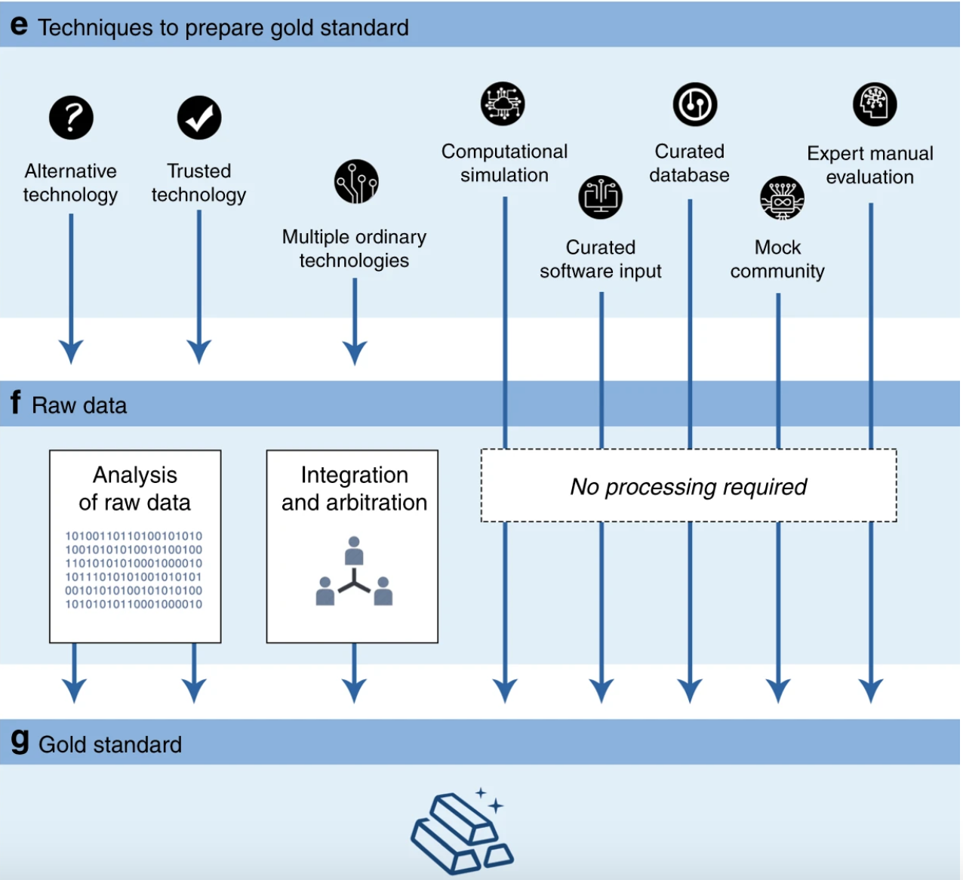
How to prepare gold standard?
Notes:
Extremely complicated and laborious process

Slide 7
Which techniques are the most popular?
*based on 25 benchmarking studies published across 10 relevant peer-reviewed journals from 2011 to 2017

Slide 8
Technique | Advantages | Limitations
Trusted technology | High accuracy Direct, usually, no computational inference is required | Carries high cost Does not scale
Alternative technology | Direct, usually, no computational inference is required | Not necessarily more accurate
Multiple ordinary technologies | Using a consensus between the technologies allow reducing the number of false positives compared to each individual technology | Disagreement between used technologies results in the incompleteness of the gold standard
Mock community | Ground truth is fully known, because raw data is generated from prepared gold standard | The small number of items (e.g., microbial species) compared to reality The designed community is artificial
Curated database | Allows access to sensitivity, by comparing the number of elements in the sample and the database | Incompleteness of curated databases results in limited ability to define true positives and false negatives
Computational simulation | Ground truth is fully known, because raw data is generated from prepared gold standard Cost-free generation of multiple gold standards | Technology is simulated, and cannot capture true experimental variability and will always be less complex than real data Gold standard data is artificial

Slide 9
How to improve simulated data?
incorporate real and simulated data in one comprehensive data set
subsampling real datasets to generate new datasets with known properties

Slide 10
Individual vs. competition-based benchmarking
Individual. Single research groups conduct individual benchmarking studies of relevant computational problems
Challenge-based. An organized competition in which participants compete to solve the problems
*based on 25 benchmarking efforts published across 10 relevant peer-reviewed journals from 2011 to 2017
Notes:
Challenge-based benchmarking was pioneered by Critical Assessment of protein Structure Prediction42, the first community-wide contest held in 1994

Slide 11
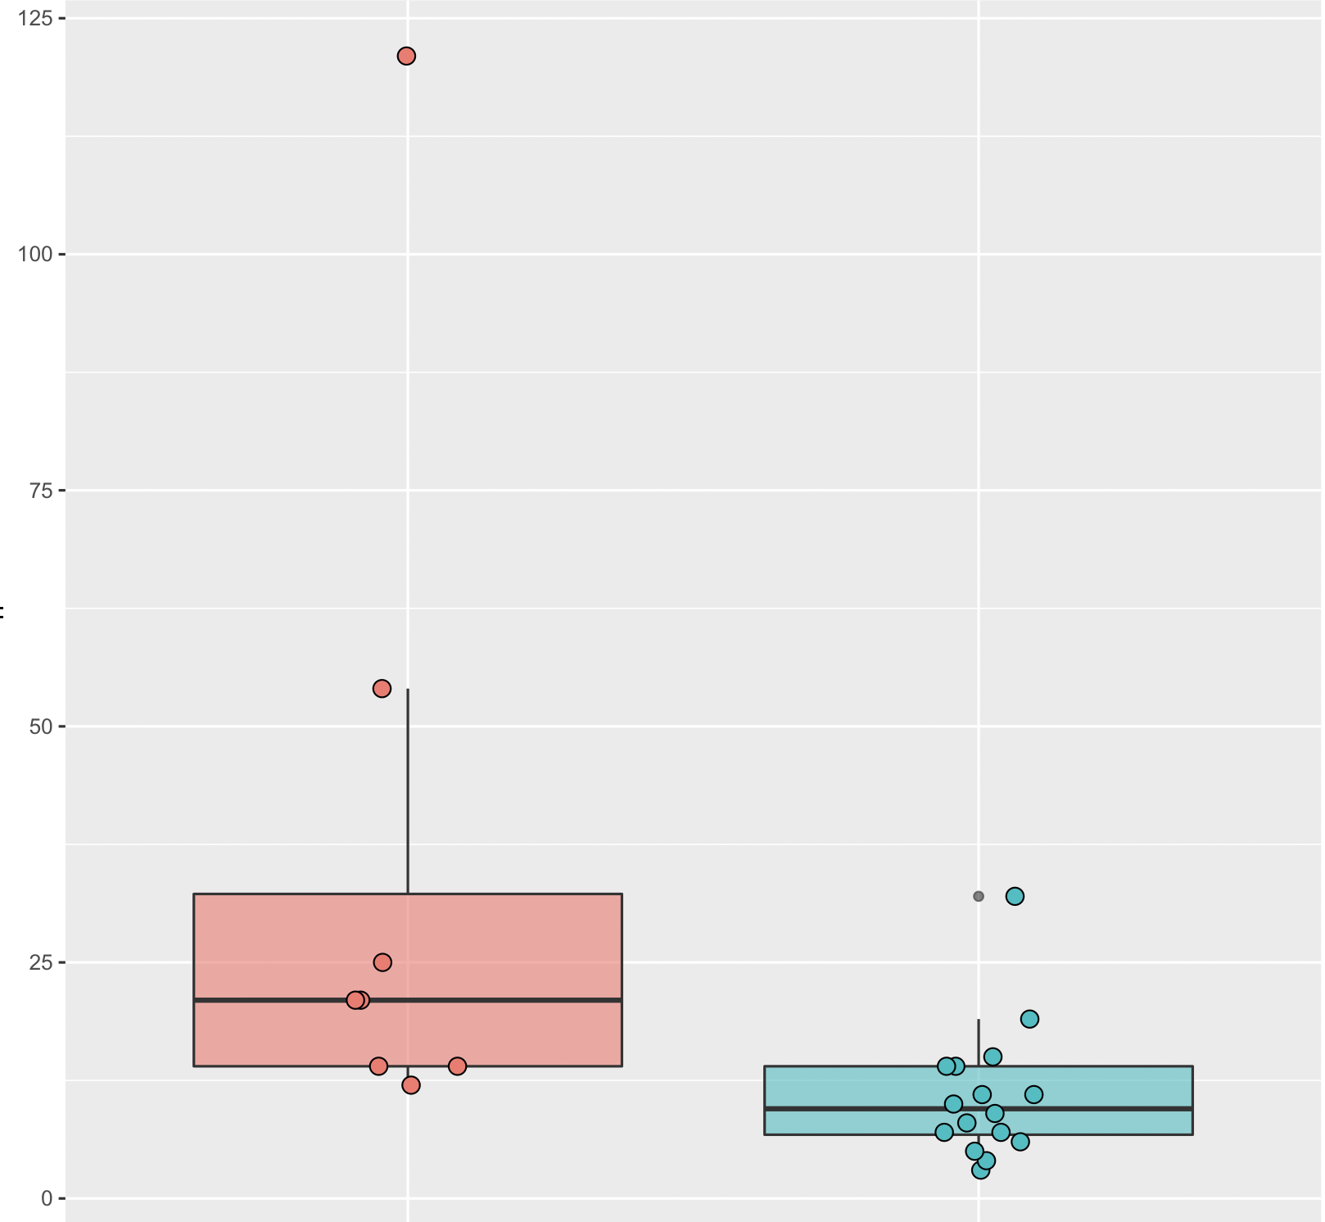
Number of benchmarked methods
many tools require a complicated installation process (~22%*)
some tools are impossible to install and run in a reasonable amount of time (~28%*)
many tools lack comprehensive documentation (~60% of installable tools*)
Challenge-based
Individual
*based on 98 randomly selected tools across various domains of computational biology (Mangul et al. PLoS Biology 2019)
based on 25 benchmarking efforts published across 10 relevant peer-reviewed journals from 2011 to 2017

Slide 12
Parameter optimization
Evaluating a software tool is non-binary decision
Competition-based benchmarking studies rely on the expertise of the tool’s developer to choose optimal parameters
Notes:
For example, tuning parameters of RNA-Seq aligners consistently increases the number of correctly mapped reads by an average of 10% across all 14 state-of-the-art aligners

Slide 13
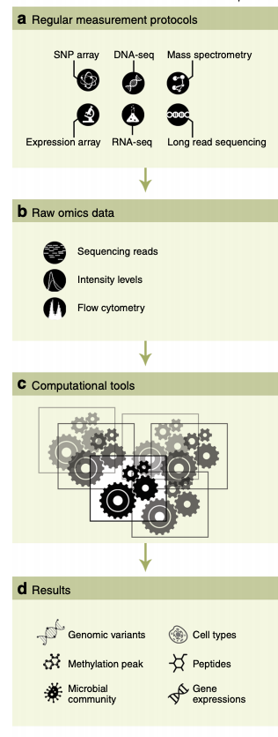
Benchmarking data and supporting documentation
Data and code are often not shared (40%*)
an absence of journal policies requiring the public sharing of these resources
Infrastructural challenges to sharing large data generated by the benchmarking studies
*based on 25 benchmarking efforts published across 10 relevant peer-reviewed journals from 2011 to 2017

Slide 14
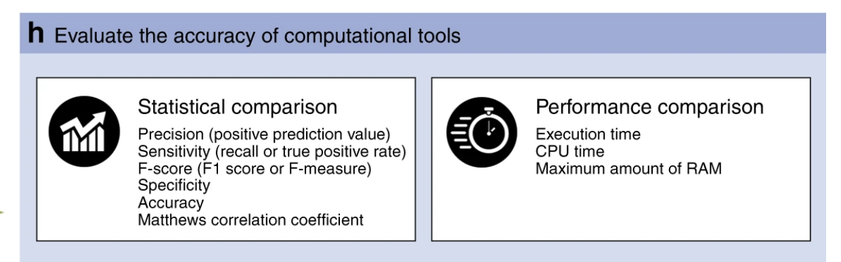
Evaluate performance of the tools
defining statistical measures is an extremely complicated and ambiguous process
sensitivity and PPV were the most popular measures
performance comparison is often ignored (72%*)
*based on 25 benchmarking efforts published across 10 relevant peer-reviewed journals from 2011 to 2017

Slide 15

Other important aspect of benchmarking
Continuous benchmarking
Incentivizing community adoption

Slide 16
Principles for systematic benchmarking
Compile a comprehensive list of tools to be benchmarked
Prepare and describe benchmarking data
Carefully select evaluation metrics and pack in form of scripts (which the community can later use)
Consider parameter optimization
Summarize algorithm features and share commands for installing and running tools (preferably as virtual machine images or containers)
Provide a flexible interface for downloading data

Slide 17
Open questions
How can we encourage the research community to work on benchmarking?
How can we address concern that benchmarking work may foster negatively competitive sentiments in the research community?
How we can allocate funding for benchmarking research?

Slide 18
Involving undergraduates in genomics research to narrow the education–research gap
S. Mangul, L. S. Martin, and E. Eskin. "Involving undergraduates in genomics research to narrow the education–research gap." Nature Biotechnology

Slide 19
Acknowledgment
Lana S. Martin
Brian Hill
Angela Ka-Mei Lam
Margaret Distler
Alex Zelikovsky
Eleazar Eskin
Jonathan Flint

Slide 20
The Mangul lab is looking for postdocs!
Want to work at USC and live in Los Angeles?
Want to develop cool cutting edge bioinformatics methods and apply them across the largest datasets?

